Slide 1

TOP ASSISTS PREDICTION
BY: KARTHIK LANKA
Mentor : nalla suman

Slide 2
PROJECT OVERVIEW
This project develops a machine learning system designed to forecast the number of assists a Premier League player is likely to record. The models leverage detailed player statistics, including key passes, assists per 90 minutes, shot assists, completed crosses, and prior season performance data spanning the 1993–2024 Premier League seasons.

Slide 3
OBJECTIVE & MOVTIVATION
OBJECTIVE
This project aims to develop a machine learning system capable of accurately forecasting the number of assists a Premier League player is likely to achieve. The model utilizes extensive player statistics, including key passes, assists per 90 minutes, shot assists, completed crosses, and historical performance data from the 1993–2024 Premier League seasons. By analyzing these features, the system seeks to uncover hidden patterns in player creativity and playmaking efficiency, ultimately transforming raw football data into predictive insights that can guide strategic decisions.
MOTIVATION
The motivation behind this project stems from the growing importance of data-driven analysis in modern football. Predicting player assists is not only vital for understanding individual performance but also for supporting key applications such as fantasy football, club recruitment, and tactical analysis. Accurate assist prediction enables fantasy players to make informed team selections, helps clubs identify and recruit top creative talents, and assists coaches and analysts in evaluating a player’s contribution to goal creation. Machine learning serves as a virtual football analyst, continuously learning from data to predict future performance and reveal insights that traditional methods often overlook.

Slide 4
PROJECT FLOW
1)Understanding Problem Statement & Data Collection
2)EDA (Exploratory Data Analysis )
3)Model Selection & Training
4) Hpyerparameter Tunning
5) Evaluation
6)Deployment

Slide 5
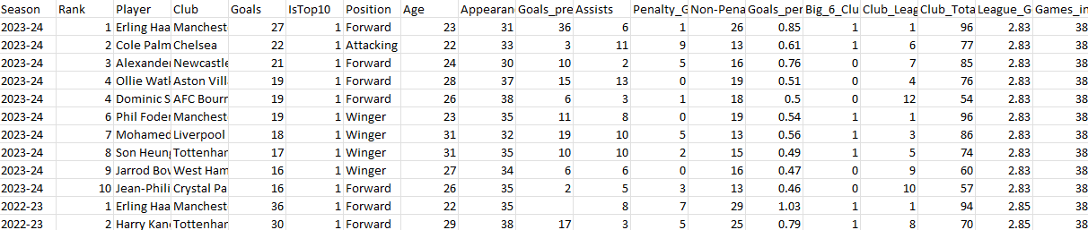
UNDERSTAND PROBLEM AND COLLECT DATA
AIM/GOAL:
Develop a regression model to estimate the number of assists a Premier League player is likely to record.
Problem Type:
Regression task — predicting a continuous target variable (assists ranging from 1 to 20).
Dataset Overview:
Data collected from the 1993–2024 Premier League season featuring 212 players.
Includes 24 detailed performance attributes covering various player statistics and metrics.

Slide 6
EDA- EXPLORATORY DATA ANALYSIS
Exploratory Data Analysis (EDA) in Machine Learning is a critical step that helps you understand your dataset, detect patterns, and prepare it for modeling, it follows these steps.
Data Collection & Loading
Data Inspection
Data Cleaning
Univariate Analysis
Bivariate / Multivariate Analysis
Feature Engineering
Data Visualization
Summary of Findings

Slide 7
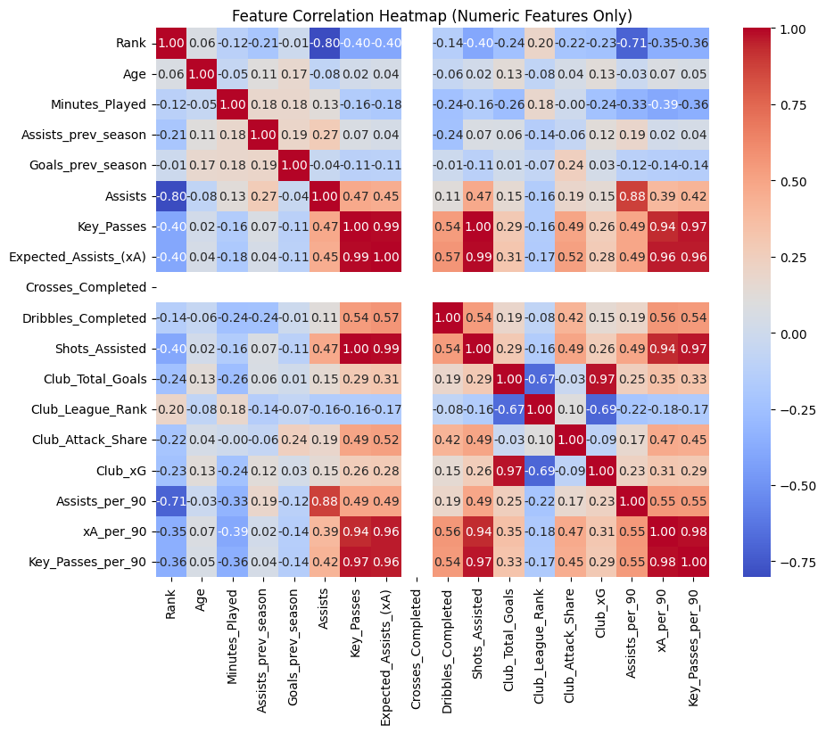
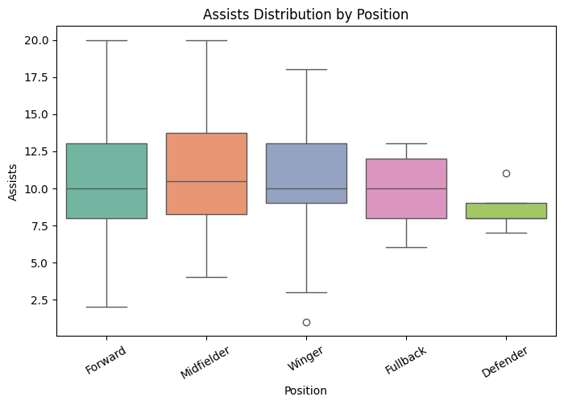
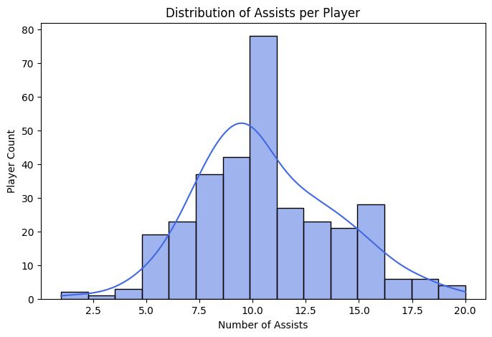
Visualization and Analysis

Slide 8
INSIGHTS FROM EDA
Strong correlations with Assists:
Assists_per_90 (0.88) → reinforces why it’s most important in RF.
xA_per_90 (0.39) and Key_Passes (0.47) → moderately correlated; contribute but less than efficiency metrics.
Multicollinearity observed:
Key_Passes vs Expected_Assists_(xA) (0.99) → almost perfectly correlated.
Shots_Assisted vs Key_Passes (~0.97) → high correlation.
Insight: Some features provide redundant information; the model could be simplified without losing predictive power.
Negative correlations:
Rank (-0.8) → Higher rank (lower number = better ranking) is associated with more assists.
Minor negative correlations with age and minutes_played are almost negligible.
Interpretation:
Per-90 efficiency metrics (Assists_per_90, xA_per_90) drive predictions.
Raw totals (Key_Passes, Shots_Assisted) are redundant with per-90 metrics.
Player ranking is an indirect predictor: better-ranked players tend to have more assists.

Slide 9
Model Selection & Training
Chosen Model: Random Forest Regressor ✅
Reasons for Selection:
Captures Non-Linear Relationships – Can model complex interactions between player performance metrics.
Robust and Stable Predictions – Ensemble nature reduces overfitting and improves generalization.
Handles Multiple Features – Works well with numerical and categorical variables after encoding.
Interpretability via Feature Importance – Helps identify key metrics influencing assists.
High Predictive Accuracy – Provides strong performance on test data, as reflected by R² = 0.964.
Model Training
Data Preparation:
Selected features: Age, Position, Minutes Played, Assists Prev Season, Goals Prev Season, Key Passes, Expected Assists (xA), Shots Assisted, Assists Per 90, Goals Per 90, Shots Assisted Per 90.
Target: Assists.
Encoded categorical features with LabelEncoder.
Split data: 80% training, 20% testing.
Based on these factors we trained the model.

Slide 10
HPYERTUNNING
Hyperparameters Used (Random Forest)
n_estimators = 200
Number of trees in the forest.
Reason: More trees reduce variance and provide stable, robust predictions.
max_depth = 10
Maximum depth of each tree.
Reason: Controls overfitting by preventing trees from growing too deep.
min_samples_split = 5
Minimum number of samples required to split a node.
Reason: Ensures nodes are not split on very small data subsets, improving generalization.
random_state = 42
Seed for reproducibility.
Reason: Guarantees consistent results across multiple runs.
Overall Impact:
These tuned hyperparameters balance accuracy, stability, and generalization, resulting in R² = 0.964 and RMSE = 0.67 on the test set.

Slide 11
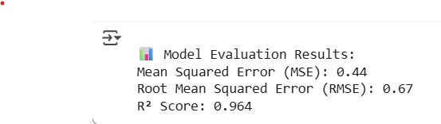
EVALUATION/RESULTS
Model Evaluation / Results
Mean Squared Error (MSE): 0.44
Low average squared error between predicted and actual assists.
Root Mean Squared Error (RMSE): 0.67
Typical prediction error is less than 1 assist per player.
R² Score: 0.964
The model explains 96.4% of the variance in player assists.
Feature Importance:
Key metrics like Key Passes, Expected Assists (xA), and Assists per 90 significantly influence predictions.
Insights:
The Random Forest model generalizes well to unseen data.
Predictions are accurate and robust, suitable for player performance analysis and scouting.

Slide 12
DEPLOYMENT
Project Deployment
Platform: Render (Cloud Hosting)
Provides a reliable and scalable environment for web applications and APIs.
Purpose:
Hosts the Premier League Assists Prediction Model as an interactive service.
Allows users to input player statistics and get predicted assists in real-time.
Backend:
Python (Flask) serving the Random Forest model.
Frontend / Interface:
Simple interface to input features like Age, Position, Minutes Played, Key Passes, etc., and display predictions.
Benefits:
Accessible from anywhere with an internet connection.
Demonstrates a full ML lifecycle: data preprocessing → model training → deployment → predictions.
Project Link:
You can share your live URL (e.g., https://epl-hub.onrender.com) to showcase the working model.

Slide 13
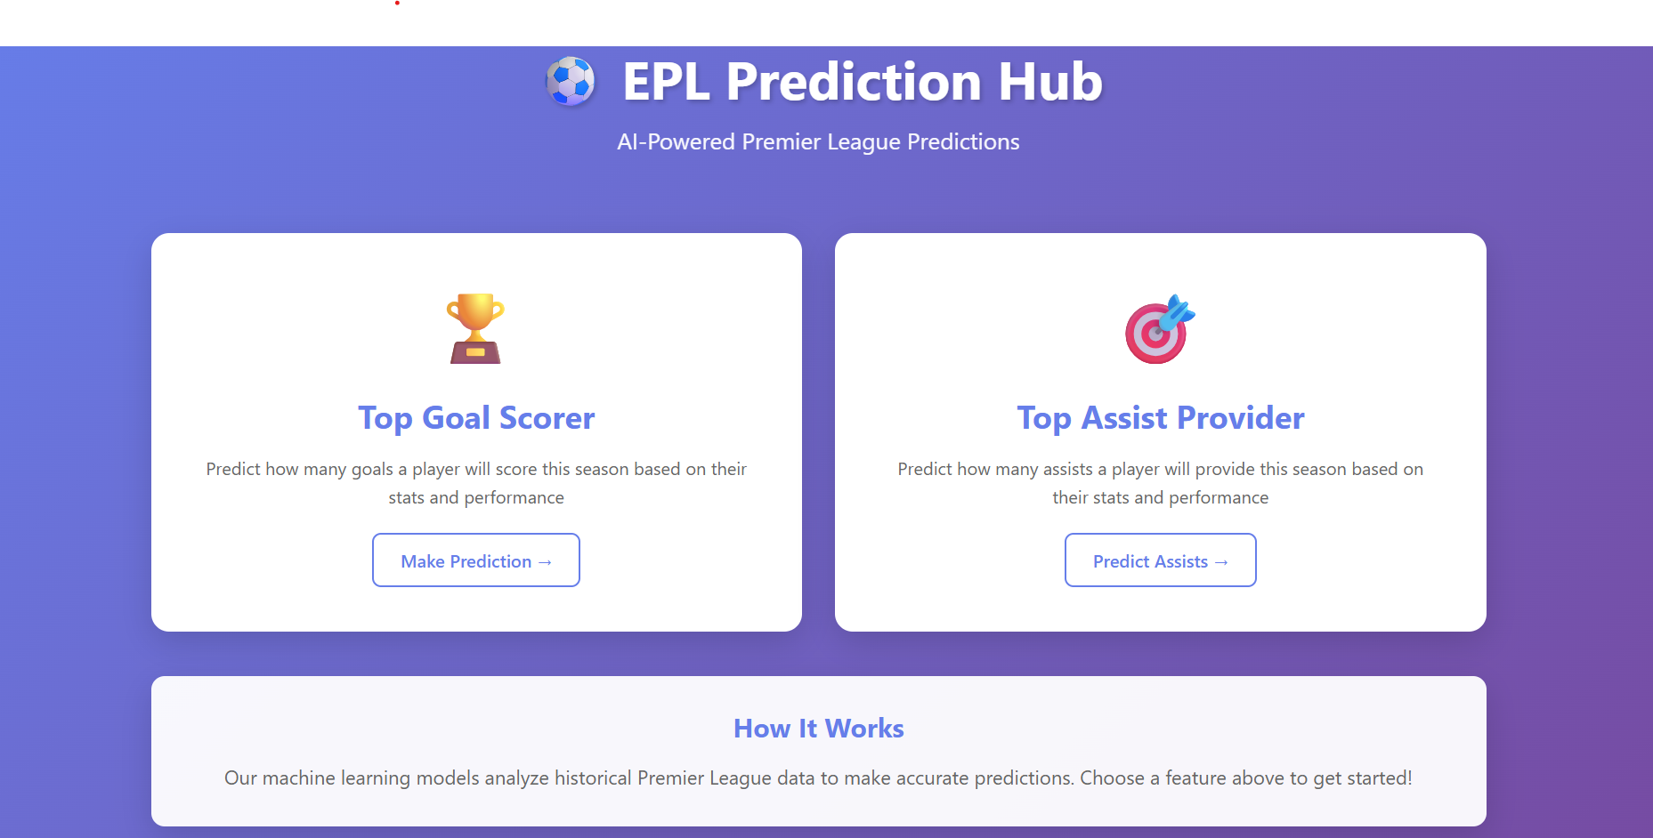
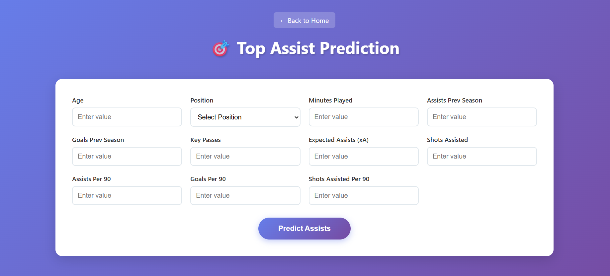
APPLICATION UI

Slide 14
ACKNOWLEDGMENT
I would like to sincerely thank Mr. Nalla Suman, my trainer and mentor, for his constant guidance, support, and constructive feedback throughout this project. His encouragement and valuable insights greatly helped me grasp and apply machine learning concepts effectively.
I am also grateful to Infosys Springboard for providing this opportunity to work on a practical and engaging project, which significantly enhanced my technical and analytical skills.
Finally, I would like to acknowledge the contribution of open-source tools and resources such as Kaggle, Scikit-learn, and Streamlit, which were instrumental in the successful completion of this project.

Slide 15
THANK YOU

